Slide 1


Slide 2
Dimensional Modelling
Why
?
Notes:
Why build a dimensional model?

Slide 3
Transactional Model?
Why not
Notes:
Why can’t we use a transactional model for our reporting needs?
After all, transactional is very good for quick inserts & updates to small amounts of data.
Those hour by hour trickle changes. Sale here, purchase there. Optimised for this.
Edgar Codd originally proposed it.
It’s highly normalised (3NF).

Slide 4
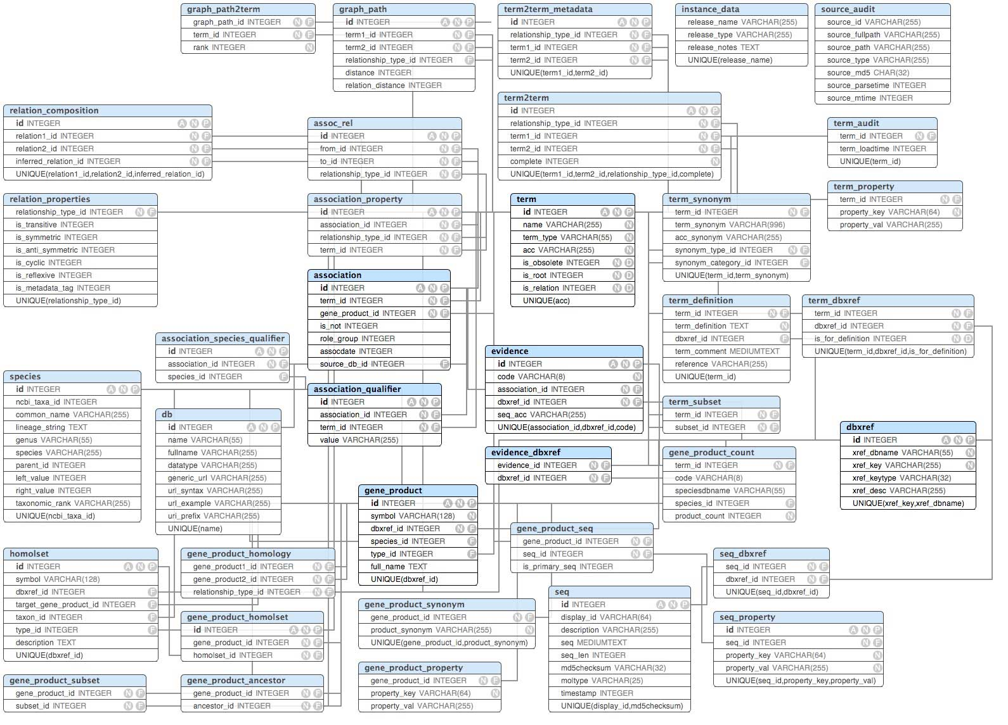
Notes:
However, for modern day businesses there are too many tables, too complex.
Difficult to maintain, understand & remember.

Slide 5
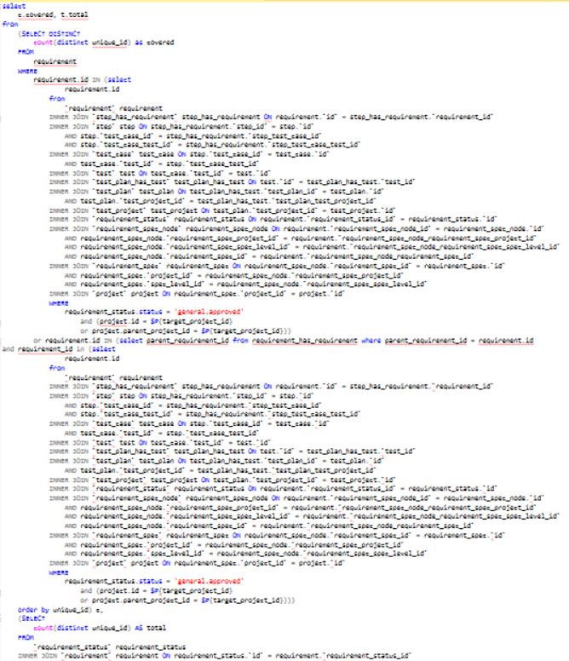
Notes:
Writing SQL statements a nightmare.
Much slower calculations & reports.
Not suitable for many business needs.

Slide 6
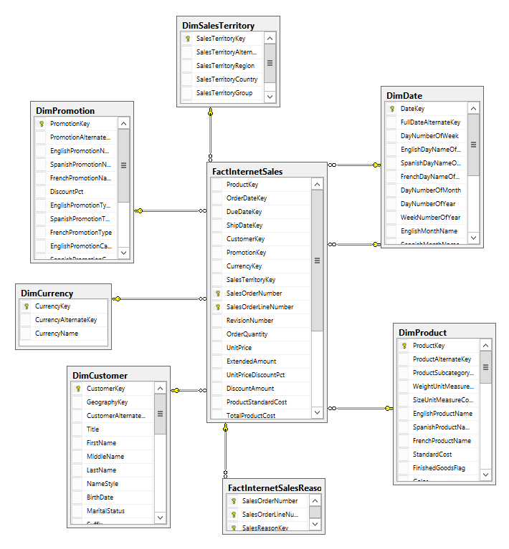
Notes:
I present the dimensional model.
It is denormalised and is a star schema.
Bill Inmon & Ralph Kimball.
Easy to maintain, understand & remember.
Optimised for scans of large amounts of data & analytical queries.

Slide 7
Notes:
It should be understood that the two work hand in hand:
Transactional as an initial source.
With a data warehouse solution to transform it into a dimensional model.
Leaving you with the benefits of both.

Slide 8
Notes:
What is critical to a dimensional model is design.
Bottom up. Ask the business questions.

Slide 9
10,000лв in sales
over 1 year
for Macbook Airs
Notes:
Alone doesn’t tell us much.
We need context.
Ok, date context.
Ok, product context.

Slide 10
Date dimension
10,000лв in sales
over 1 year
for Macbook Airs
Sales fact
Product dimension
Notes:
What does this all mean? How to create dimensional model from this?
How do we differentiate between them?
Not an exact science, but clues.

Slide 11
Product Dimension
Product Key
Product Code
Product Name
Brand Name
Cost
Unit Price
Date Key
Customer Key
Product Key
Quantity
Unit Price
Order Fact
Customer Dimension
Customer Key
Customer Code
First Name
Last Name
Date of Birth
Address Line 1
Address Line 2
City
Place of Work
Job Title
Date Dimension
Date Key
Day
Month
Year
Day Number of Week
Day Number of Month
Day Number of Year
Notes:
Dimensions = text, Facts = numbers.
Facts can be aggregated (add two project codes).
Facts increment over time
Hopefully a sale everyday
But you won’t get a sale of a new product each day.
Laptops are sold everyday, but new laptops don’t come out everyday.
Facts contain two things:
Surrogate keys to dimensions.
Numerical figures.
What is a single row in a fact? Important. If 1 row is 1 year, we cannot go lower.
We must go as low as the source system will allow us, 1 row per order is ideal.
Then we can aggregate to 1 year or 6 months, this is how we calculate measures.
What 1 row equals is called the granularity, or grain.
Dimension hosts information about a single entity. And aims to tell everything about it.
Business keys are not suitable, surrogate keys must be used.

Slide 12
Matt Willis
Matt Willi
Notes:
When constructing a dimensional model, it’s important to clean the data.
To correct it if it’s dirty.
And to get one single version of the truth.
So let’s say, there are 2 sources of data, displaying 2 versions of me.
It’s important to identify what is wrong, to correct it.
And to make sure there is only one version of the truth.

Slide 13
Notes:
We’ve covered a lot.

Slide 14
Dimensional Modelling
Demo
Notes:
We will go through a demo, going over some of these points.
I will show you using PBI how we can go from a transactional DB to a dimensional DB.
Similar to what we do with POC.
And similar to your assignment.

Slide 15
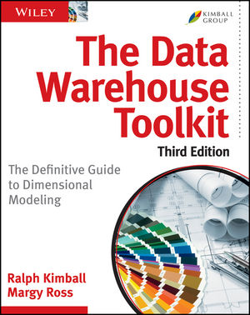

https://www.kimballgroup.com/data-warehouse-business-intelligence-resources/
https://www.thoughtspot.com/fact-and-dimension/dimensional-data-modeling-4-simple-steps
github.com/matt-willis
blogs.adatis.co.uk
https://powerbi.tips/category/data-modeling/
https://www.tutorialspoint.com/power_bi/power_bi_data_modeling.htm
https://www.guru99.com/data-warehousing.html

